Slide 1
CMSC 449/691 Malware Analysis
Lecture 4
Packed Malware

Slide 2
Malware Packers
Malware authors want to make it difficult for you to perform static analysis on their malware
Use packers to hide the malware’s executable code
Often, the process of packing also hides strings and function imports from static analysis too

Slide 3
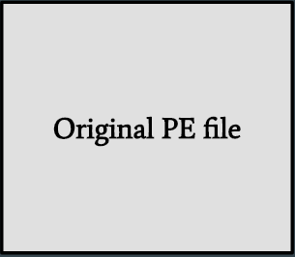
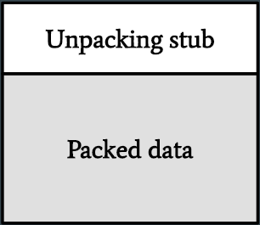
How Packers Work
Packers obfuscate the executable code in the executable code, and then add an unpacking stub
When the packed executable is run, the stub unpacks the compressed program into memory and runs it

Slide 4
Analyzing a Packed File
Unable to do advanced static analysis – the only visible code is the unpacking stub
And packers can be nested!
Most packers do not have a public “unpacking” tool available
Instead, we are forced to run the file or manually unpack it
Will teach how to manually unpack files much later
Execute until the unpacking stub finishes, then dump memory

Slide 5
Indicators that a File is Packed
File / Section entropy > 7
Few readable strings
Unusual section names
Sections with unusual raw / virtual sizes
Imports resolved using runtime linking
Few (often complex) functions visible in the malware’s code
PEiD, DIE, VirusTotal are decent at detecting packers
Notice lots of some false positives for some packers though

Slide 6
Shannon’s Entropy
Measures the randomness of a sequence
Useful for figuring out what a byte sequence represents!
A byte has 2⁸ possible values, so a truly random byte sequence has an entropy of 8
Executable code usually has an entropy around 4-6
Obfuscated / encrypted data usually has an entropy over 7, often near 8
Empty regions of a file (mostly 0x00) have low entropy

Slide 7
Runtime Linking
Most packers use runtime linking to further obfuscate the file
Runtime linking allows malware to “import” a function without listing it in the Import Address Table
This makes static analysis harder
Done by loading a DLL, then finding a function in the DLL
LoadLibrary – Windows API function that loads a DLL
GetProcAddress – Returns a pointer to a function in a DLL

Slide 8
Unusual Section Properties
Packers often add PE sections to a file with unusual names
The UPX packer adds the “UPX0” and “UPX1” sections
A packed file often has a large section with very high entropy
Stores the packed data
May also have an empty section with high virtual size
Where the packed data is loaded when the file runs
May also have writeable + executable section characteristics

Slide 9
Please download and install the Slido app on all computers you use
Choose the answer that does NOT indicate that a file is packed
ⓘ Start presenting to display the poll results on this slide.

Slide 10
Packing Indicators Demo
Lab01-02.exe
Lab01-03.exe
Notes:
Lab01-02.exe can be packed using upx –d

